Slide 1

WELCOME

Slide 2
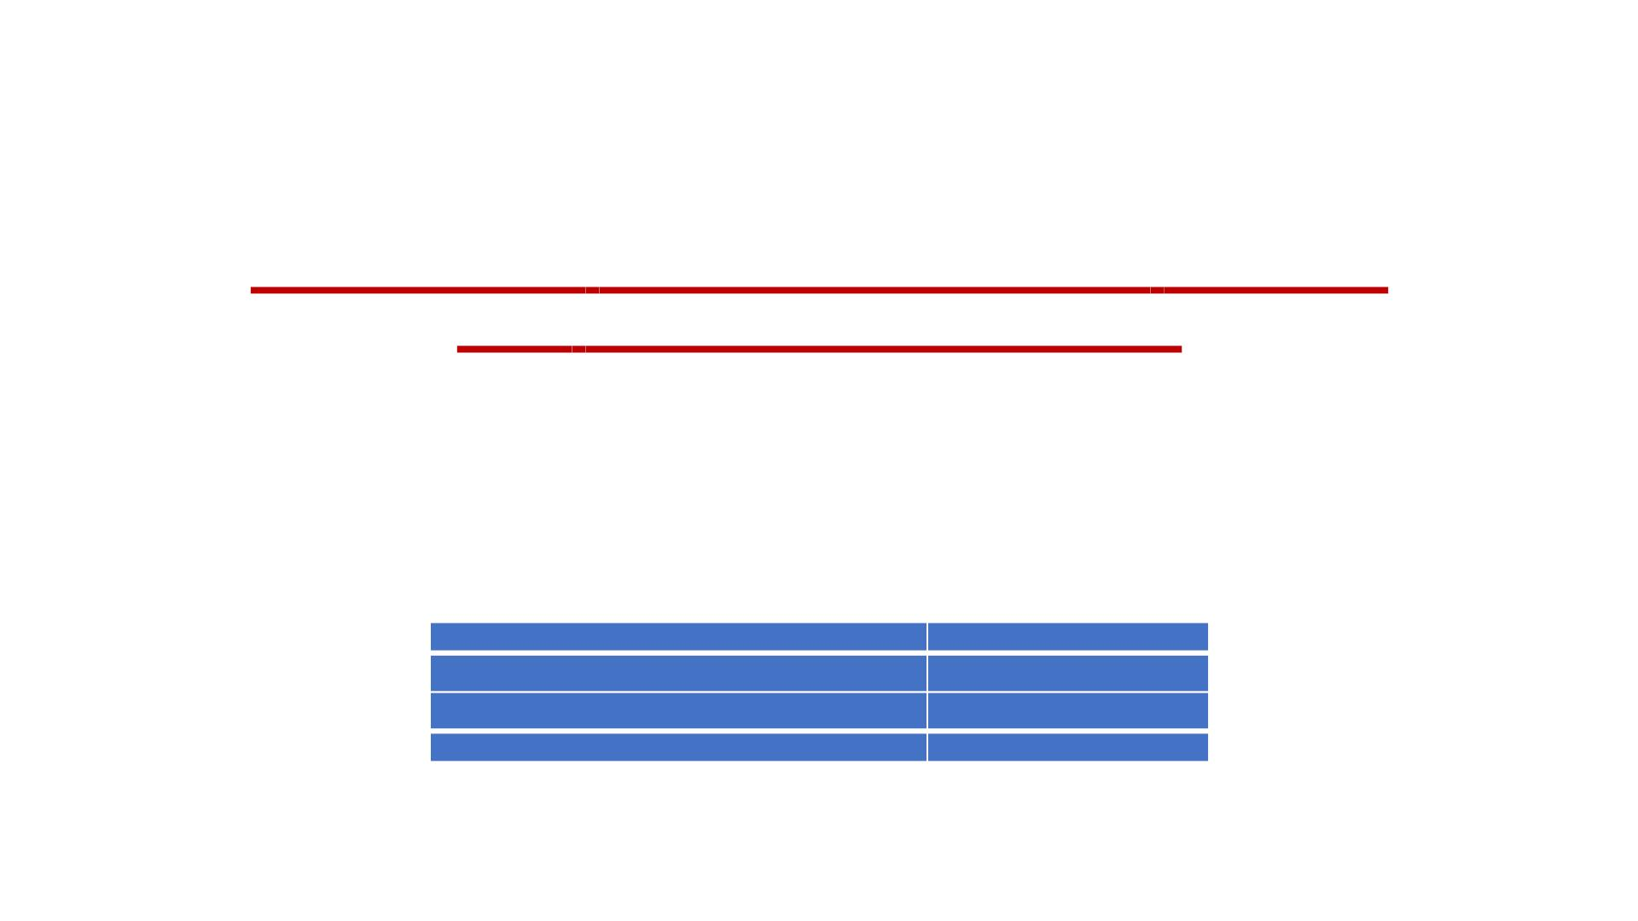
FERTILIZER RECOMMENDATION SYSTEM
FOR DISEASE PREDICTION
NALAIYA THIRAN PROJECT REPORT
IBM-Project-10083-1668681292
TEAM ID: PNT2022TMID32003
Presented by
RAKKESH S
(731619104048)
(731619104006)
ARUNPRAKASH C
PRASANTH S
(731619104043)
(731619104001)
ABINANTHAN R
Guided by
R.DEEBIKA AP/CSE
KSRIET

Slide 3
PROBLEM STATEMENT
Mr. Narasimma Rao is a 65-year-old man. He had an own farming
land and do Agriculture for past 30 Years, in this 30 Years he Faced a
problem in Choosing Fertilizers and Controlling of Plant Disease.
•
Narasimma Rao wants to know the better recommendation for
fertilizers for plants with the disease.
•
•
•
He has faced huge losses for a long time.
This problem is usually faced by most farmers.
Mr. Narasimma Rao needs to know the result immediately.

Slide 4
PROPOSED SOLUTION
• The solution to the problem is machine learning which is one of the applications of Artificial
Intelligence, is being used to implement the proposed system. Crop recommendation is going
to recommend you the best crop you can grow in your land as per the soil nutrition value and
along with as per the climate in that region. And recommending the best fertilizer for every
particular crop is also a challenging task.
• The other and most important issue is when a plant gets caught by heterogeneous diseases
that effect on less amount of agriculture production and compromises with quality as well. To
overcome all these issues this recommendation has been proposed .
• Nowadays a lot of research and work is being implemented in the smart and modern
agriculture domain. Crop recommendation is characterized by a soil database comprised of
Nitrogen, Phosphorus, potassium.

Slide 5
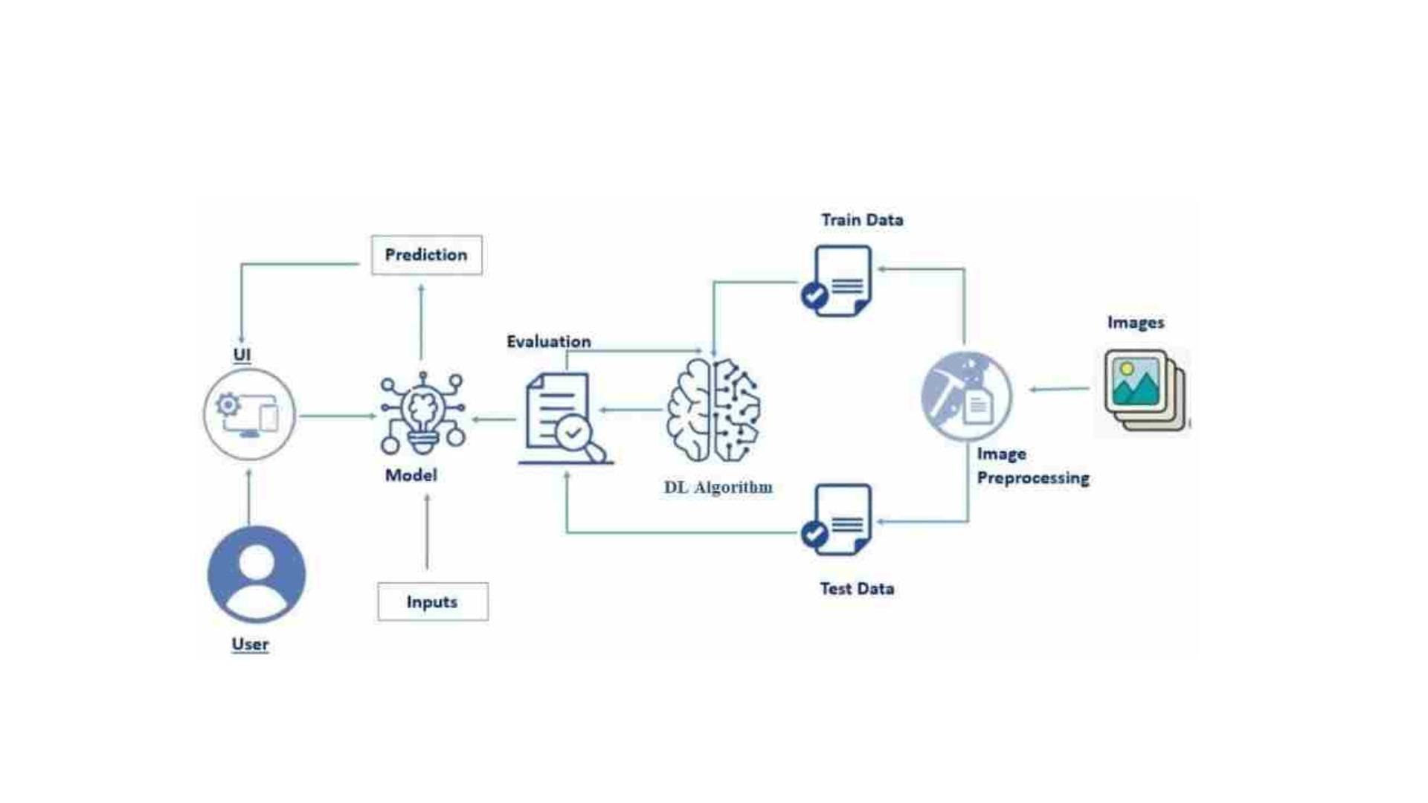
TECHNICAL ARCHITECTURE

Slide 6
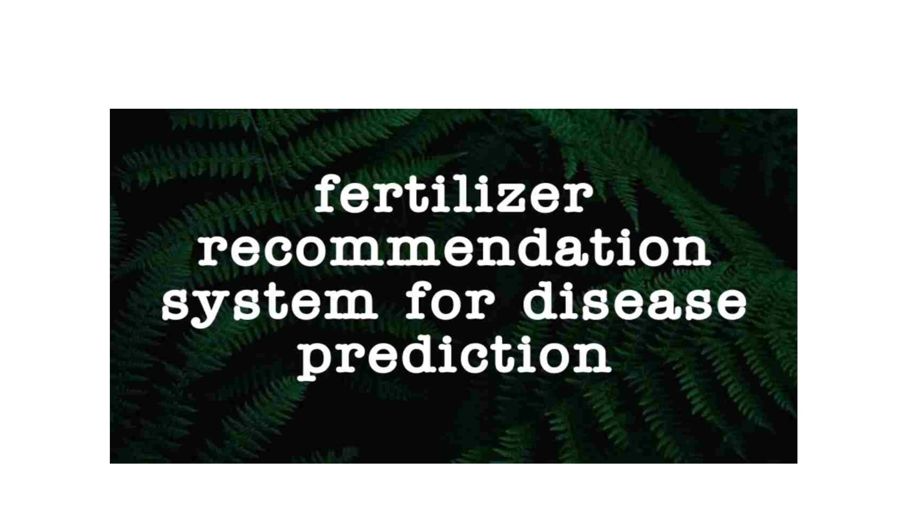
PROJECT DEMO VIDEO

Slide 7
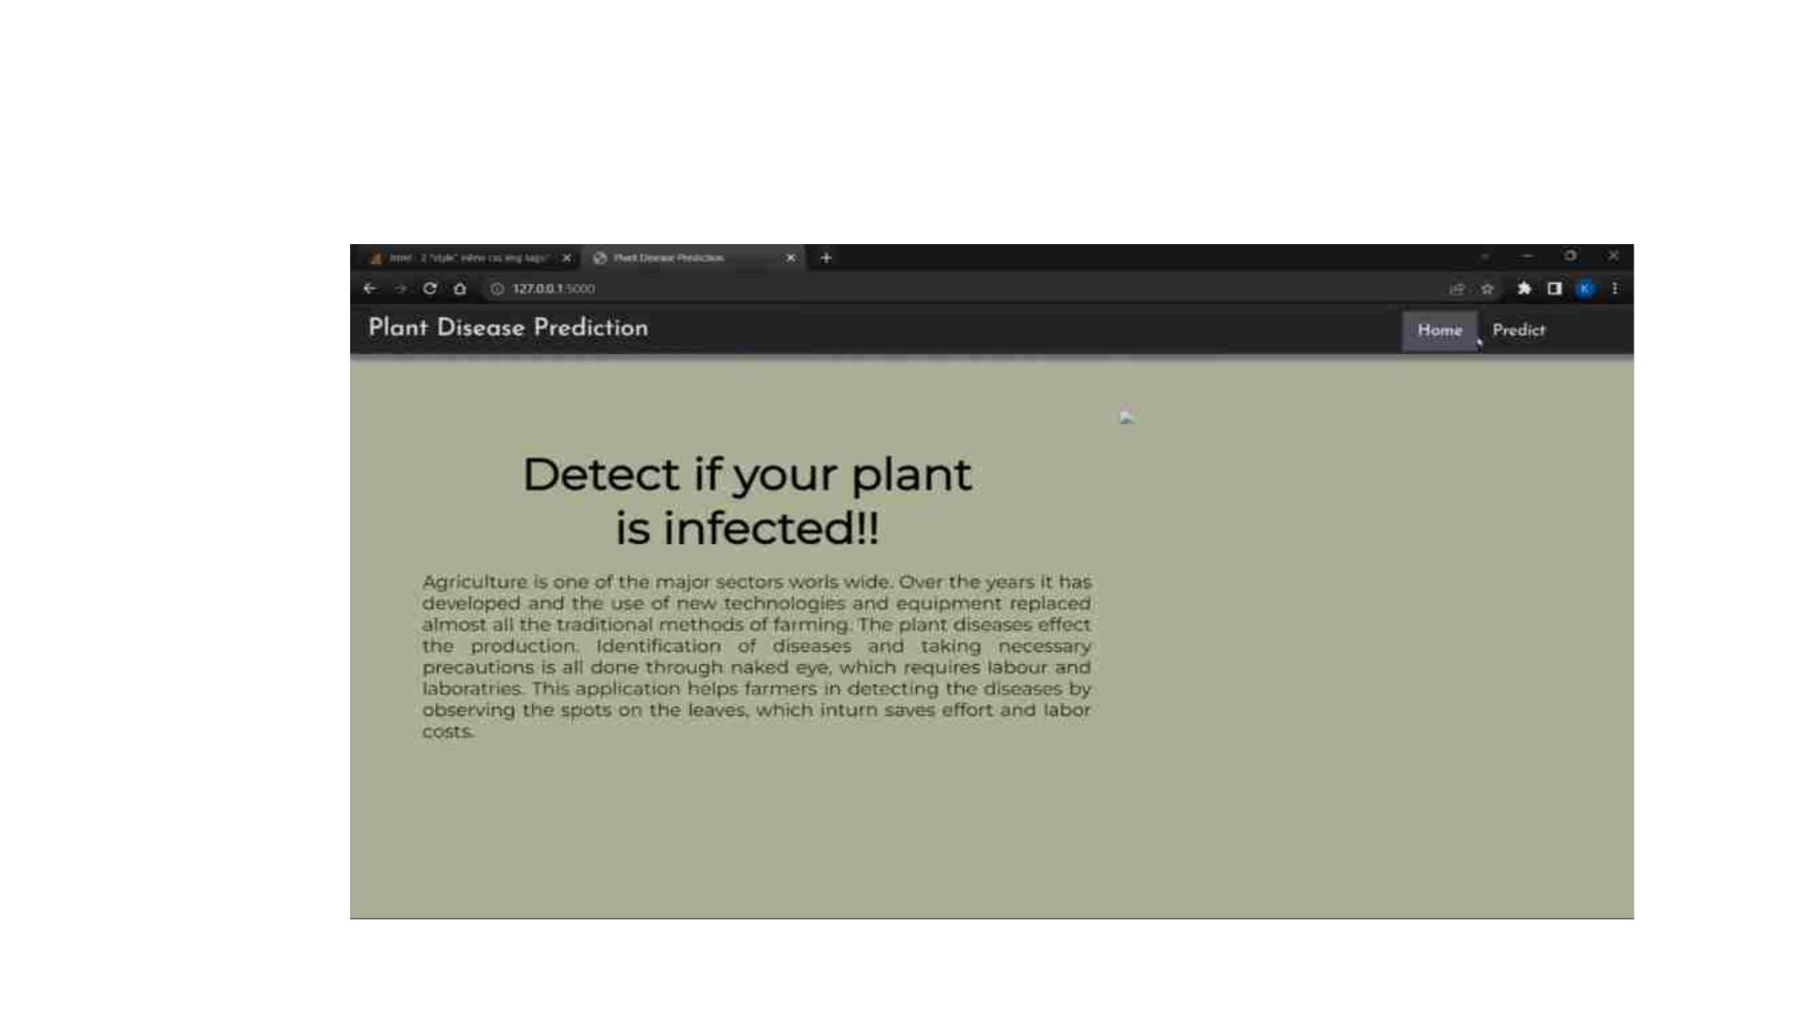
PERFORMANCE METRICES(RESULTS)
SCREENSHOT

Slide 8
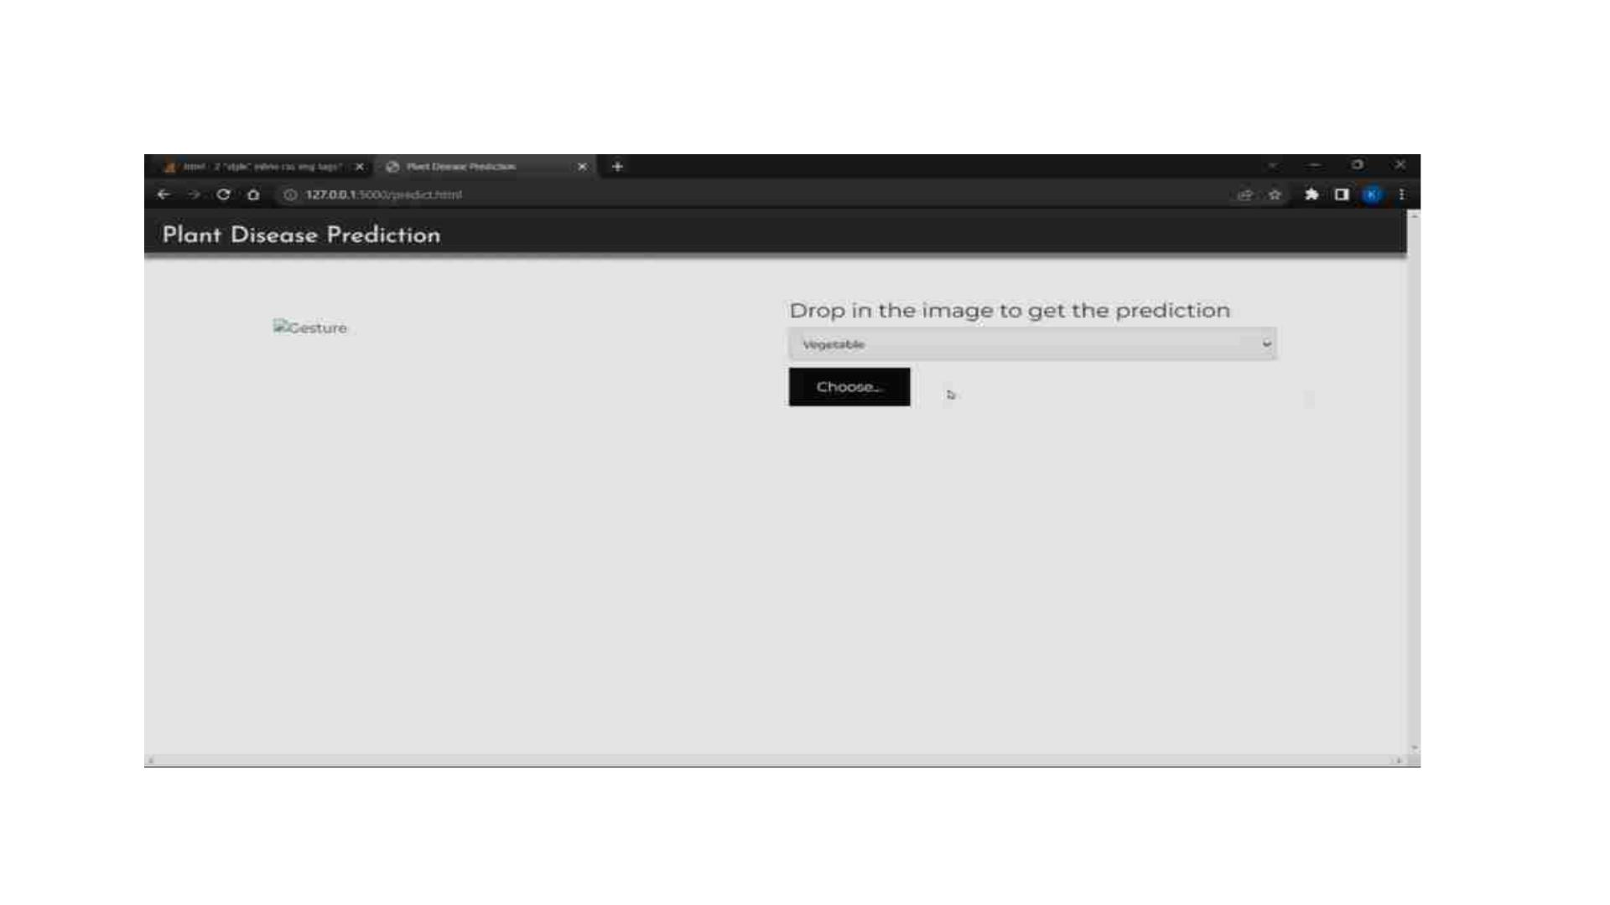

Slide 9
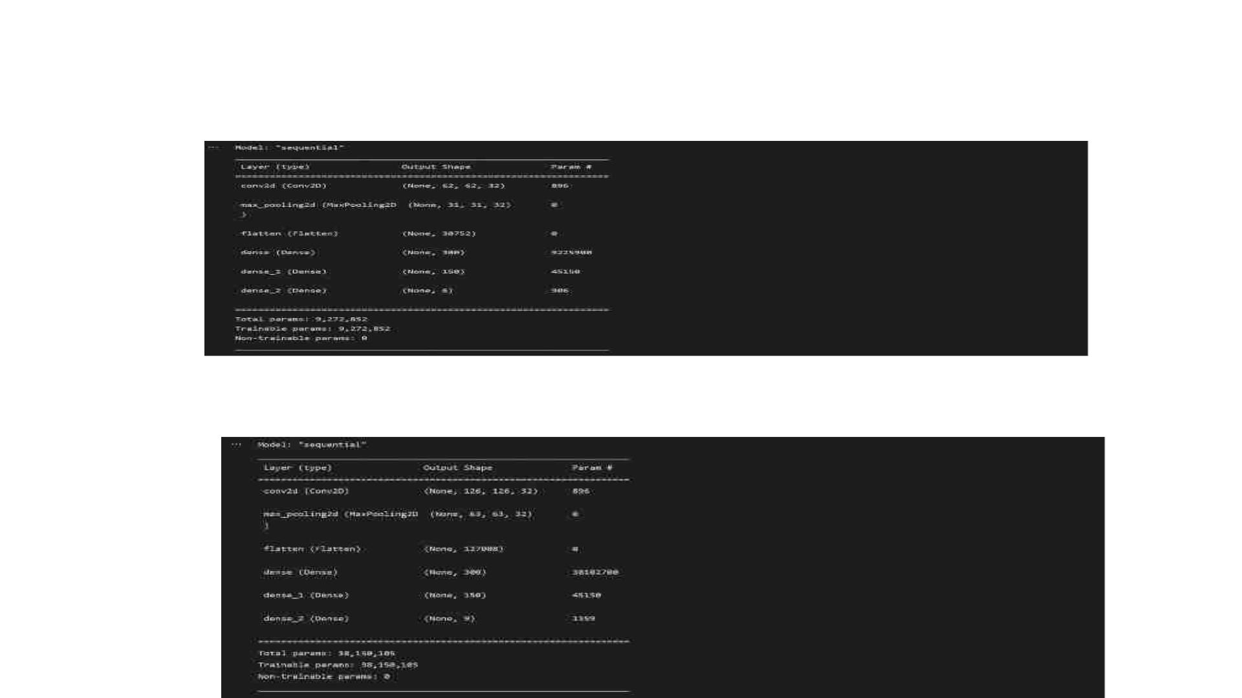
MODEL SUMMARY OF FRUITS
MODEL SUMMARY OF VEGITABLES

Slide 10
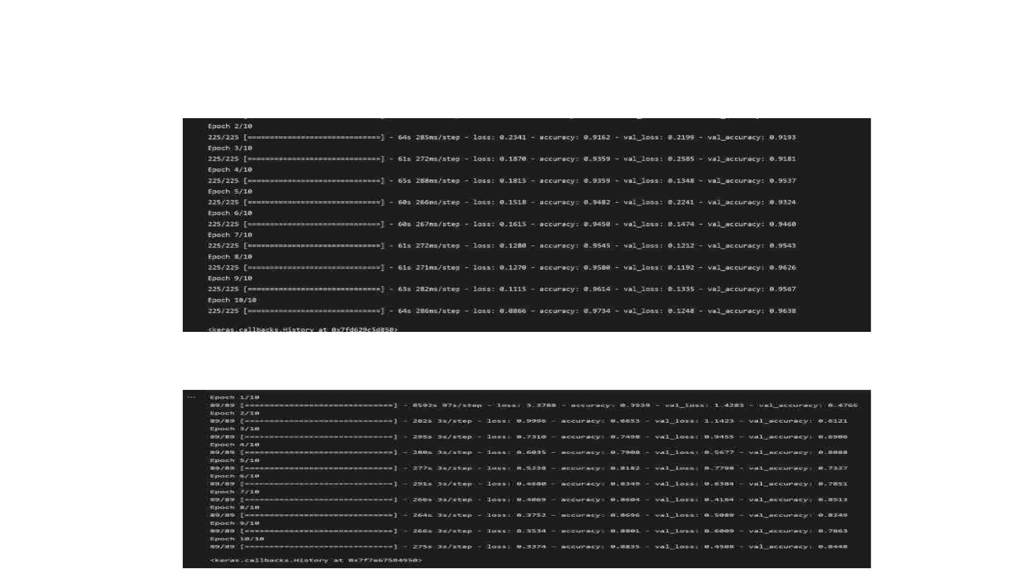
ACCURACY FOR FRUITS
ACCURACY FOR VEGITABLES

Slide 11
SCALABILITY AND FEATURES SCOPE
The system successfully interprets various Diseases and is also capable of
providing fertilizers suggestion for the respective disease. Furthermore, this system can be
made more robust by incorporating more image dataset with wider variations like more than
one leaf in a single image. An App could also be developed for the project whichcould make
the work of the farmers easier. They could directly upload image on the app and it would tell
the disease and the cure then and there. This would reduce the time and efforts. This project
is limited to just one crop for now but in the future more crops and even flowers dataset can
be added so that it is helpful for every agricultural need. Newer models can also be added
and tried with time which may result in better accuracy and would make the model even
faster.

Slide 12
THANK YOU

